Slide 1

Business Analytics Capstone Framework for Strategy
Anggi Firdian Saputra
25 August 2022

Slide 2
Problem Statement

Slide 3
Problem Statement– Describe the Problem Adblockers present to GYF
Use this space for describing the problem. Be as specific as possible! You should focus on the implications of adblockers on GYF’s ad-buying customers; in exploring this, you might also consider the implications for GYF’s end users, operations, and/or internal organization.
A major portion of GYF’s revenue comes from selling advertising to other companies who place ads on GYF’s digital services.
AdBlock is an open source content filtering and ad blocking extension for the Google Chrome and Apple Safari web browsers. AdBlock allows users to prevent certain web elements such as ads from appearing.
If GYF is unable to display ads to the customers, the companies posting the ads will have no reason to put the ads. Thus resulting in termination by the companies and loss of revenue to GYF.
1. How many end-users from our base are vanished due to ad-blockers and what segment of users are they?
Decreasing end-users would make incomplete data analytics and business analysis. So, we could not capture perfectly the end-users background, preferences, and behavior from whole end-users population as this is crucial to prospected B2B/B2C to reach their invaluable customers.
2. Why do users use ad-blockers?
The basic reason from the user is very necessary because with these basic reasons we can find out why users use adblockers. Is it because of irrelevant ads from their preferences?, is too many ads are obtained on one page?, is the design confusing?, is the image, video, and photo size not proportional?, or the page deliverable is so slow?.
3. What kind of behavior are our users before they are starting to use ad-blockers? How was our ads appearance before they are waving goodbye to our service?
This is to identify Recency, Frequency, and Monetary (RFM) to know their CLV and behavior before they start to use ad-blockers.
4. How large the monetary aftermath would be affected due to ad-blockers?
Declining end-users would also degrade our CTR possibility that would have a bad impact to conversion and revenue subsequently
5. What measures could be taken to change or strengthen GYF’s internal organization to deal with adblockers?
This is done to find a solution regarding adblockers so that we can compete with other companies, the best solution that will be obtained can increase GYF’s revenue.

Slide 4
Problem Statement– Application Exercise 1 – Research Methods and Tools (Optional)
Use this space for to answer the questions set out in Application Exercise 1: 1. Given your definition of the problem faced by GYF, what type(s) of research will you employ to learn more about the strategy the DATA Team should pursue? 2. What research tools could you use to conduct that research?
The research we will be using is Descriptive Research.
Now, we are aware of the issue of ad-blockers on GYF, where we need to reveal the implication of the issue by unleashing the numbers of how big it would impact our users base and our financial bottom line and we need to identify the root of causal problem or reason of end-users use ad-blockers.
As the next step, we will be using Causal Research, especially A/B Testing to conduct new native ads appearance to make end-users more comfortable, which ones would be a preference to the end-users to take up the conversion rate. By then we could subsequently decide what strategy we need to conduct to anticipate and mitigate if the result goes rough.
Research Tools To Conduct That Research is From:
Scanner Data. In the back-end which could track whether end-users are using ad-blockers or not. If using ad-blockers, we need to record their time stamp by using JavaScript to investigate their behavior prior to using ad-blockers. With this data, we can do modelling through ML of which from our users base are alleged to churn by using ad-blockers.
Mobile Survey. To investigate the main drivers of end-users who use ad-blockers as the causal problem.
Mobile Data Analytics. To know whether a segment of our end-users is using ad-blockers, and how far it would impact our end-users data analytics.
Social Media. To capture our ads engagement and ads personal.
Pricing Analysis. To decide which option would be suitable: charging the customers or paying the adblocking companies to get whitelisted.

Slide 5
Strategy

Slide 6
Strategy Describe your proposed strategy
Make sure your strategy is clear, well-defined, and feasible
A single strategy is not sufficient to tackle this problem. So a multiple strategy approach is recommended. The strategy of ad-blockers threat is basically lies in creating a sustainable advertisement ecosystem, where there are two strategies:
Generating a much greater advertising experience for users to see the ads without pushing them, with the following points:
Tighten Quality of Assurance (QA) of advertisement content, where the ad’s content deliverable should be a gift, delightful, informative, meaningful, useful, invisible, inspirational, and indispensable part of product and service experiences, taking into the improvement of page load time so that it does not take a long time when load the page.
Executing A/B Testing on different ads experiences to each segment of user bases. To know the end-users preference, and deploy the result which new native ads appearance suit best for each segment.
Create GYF built-in ad-blocking to make end-users choose their own preference to prohibit the access of ads or not. If they are choosing to activate the GYF built-in ad-blocking, GYF analytics still can fetch the end-users cookies, links clicked, and other data to do further analytics. For end-users who already used 3rd party ad-blockers, we are sending the prompt that asks whether they will turn off the old one and activate GYF built-in ad-blocking considering their data security is crucial to unknown 3rd party.
The Ambidextrous Tactics to boost the strategy itself, with the following points:
Create a solid culture of ads team members. By building an execution culture that lays out key decision, action, support the model and execution plan with effective incentives and controls, which take agreement and commitment are sought and rewarded consideration. This culture would lead to successful strategy execution and avoid members turnover challenges.
Create a collaborative ecosystem all across search engine companies and publishers by holding a consortium to ‘drive’ the industry that potentially becomes an industry barrier, as for the case to standardize the ads content to not be so invasive and too bloated.
If these trials fail to provide a desirable result, an analysis must be conducted on the most feasible solutions out of the following 3 options: Charging the customers vs Paying to get whitelisted vs Paying anti adblocking companies. In the end we must choose the most economic option of the three.
Although it would not be a good idea to pay the adblockers to get whitelisted since there is a chance of some other adblocker that might block our content. This should be adopted only as a short term solution.

Slide 7
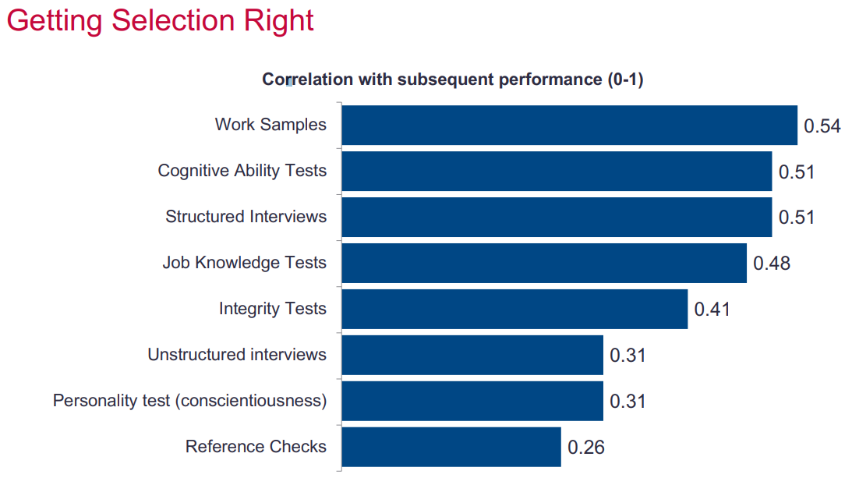
Strategy Application Exercise 2 – Hiring a Team Leader (Optional)
Based on the information provided in Application Exercise 2, describe here why you would hire Carrie Candidate or Peggy Prospect to be the second-in-command of the DATA Team.
As the leader of the DATA Team at GYF, I am looking for a new Senior Associate Director for Digital Advertising Strategy. This person will be my second-in-command as I develop and implement my strategy for addressing the problem of adblocking.
I would hire Peggy Prospect as a new Senior Associate Director for
Digital Advertising Strategy, because apart from having excellent
academic scores, she also has prior experience in the relevant field
and that experience might come in handy to save time and money in
our strategy application.
Although she scores based on metric assessment results a bit low on
the cognitive test than Carrie Candidate, the other test parameters
show promising prospects. She already has knowledge of what kind of
work is expected from her. This might save the valuable time and money
that would have been lost in training her to get acclimated to her role.
References are not a great indicator of employee performance. Hence it is
advisable to ignore it since both the candidates scored nearly similar on the
reference scale.
Peggy excels in working in a team, this is really needed to make a strategy because Peggy can communicate well and can produce a better solution. This is very necessary because making and executing a strategy requires many factors from all elements both within the company and outside the company.
Picture Metric Assessment
Bidwell, Matthew. Staffing Analytics Slide. Wharton, University of Pennsylvania.

Slide 8
Effects and Measurement

Slide 9
Effects Describe the anticipated effects of your strategy
Please describe the anticipated effects of your strategy. Make sure you address the effects on customers, revenue, and the internal organization.

Slide 10
Effects Application Exercise 3 – Designing a Deterministic Optimization Model
Provide an explanation of the calculations you performed to build an optimization model using decision variables, constraints, and an objective; this model could use the scenario in Application Exercise 3, or one of you own devising.

Slide 11
Measurement Describe the anticipated effects of your strategy and how you will measure them
Please outline your plan for measuring these effects using data. Make sure you use techniques you learned about in the courses

Slide 12
Measurement Application Exercise 4 – Identifying Key Drivers
Apply the “causal business model” performance measurement framework to your strategy

Slide 13
Conclusion
Summarize your key points from the preceding slides

